Slide 1

Nonresident US Tax Obligations for J-1 Bridge USA Participants
Navigating the nonresident tax journey

Slide 2

Before we start…
Disclaimer:
The aim of this presentation is to provide you with a general understanding of tax principles as they apply to J1 visa holders and as such, is for information purposes only. Each individual has a unique tax position and is responsible for their own tax determination and compliance.

Slide 3


Overview
Overview of tax for nonresidents on J-1 visas
Guidance around employment and receipt of US income for nonresidents
Tax filing obligations
Understand the implications of filing an incorrect tax return
Sprintax solutions

Slide 4

What determines residency for tax purposes?

Slide 5


Resident or nonresident for tax purposes?
Independent of visa/immigration status
Generally, J-1 Interns/Trainees, Summer Work and Travel, Camp Counsellors, Au Pairs, Teachers and Researchers are automatically considered nonresidents for tax purposes for 2 out of the last 6 calendar years in the US
As a nonresident for tax purposes, different tax rules apply to you and you would need to complete different tax forms than a resident for tax purposes
If you've been in the US for longer than the 2 year period, the Substantial Presence Test will determine your tax residency – 183 days

Slide 6

Employment and receipt of US income during the year

Slide 7
Federal tax withholding
Tax Rate | Single
10% | $11,600 or less
12% | $11,601 to $47,150
22% | $47,151 to $100,525
24% | $100,526 to $191,950
32% | $191,951 to $243,725
35% | $243,726 to $609,350
37% | Over $609,350
Nonresidents for tax purposes should usually be taxed at the graduated tax rates of withholding unless they have income exempt from withholding due to a tax treaty
This means that you will pay Federal tax withholding from 10% upwards depending on the level of your income during the year
Nonresidents for tax cannot use the standard deduction (exemption being Indian Students, Trainees and Business Apprentices)
If you are a J1 Au Pair who is not being taxed on your host family payments, you should set aside 10-12% of your income as you may need to pay this to the IRS upon filing your tax return
Notes:
In terms of FDAP/not effectively connected income you tend to see Jeff, what would those be and how do you manage the screening process for those payments?

Slide 8
FICA taxes
Nonresident J1s should not be paying FICA
H-1B, J-2 and TN visa-holders, are subject to FICA taxes from their first day of employment
Usually only applied to off-campus employment
  However, tax residents do pay
Opportunity to claim back
  From employer
  Via Form 843 & Form 8316

Slide 9
The Nonresident Tax Clinic
Comparison of impact of FICA taxes on employees
Visa Type | J-1 Summer Work Travel | J-1 Summer Work & Travel | J-1 Intern | J-1 Trainee
Wages | $4,000 | $5,000 | $40,000 | $50,000
US Tax Residency | Nonresident | Nonresident | Nonresident | Nonresident
FICA Taxes Withheld in error | Yes | Yes | Yes | Yes
FICA Tax % | 6.2% Social security + 1.45% Medicare tax | 6.2% Social security + 1.45% Medicare tax | 6.2% Social security + 1.45% Medicare tax | 6.2% Social security + 1.45% Medicare tax
NRA employee portion of FICA taxes that could be withheld | $306 | $383 | $3,060 | $3,825
Employer’s part withheld in error | $306 | $383 | $3,060 | $3,825
If FICA taxes are withheld in error, there are two main approaches to have the FICA taxes refunded:
Employer amends quarterly or annual tax return (941) and refund the FICA taxes back to the individual
Individual can file a tax claim via Form 843 and 8316 to the IRS

Slide 10
Who is entitled to a tax treaty?
The United States has income tax treaties with 66 foreign countries that reduces taxation on certain types of income
Whether or not a NRA is eligible is based off five primary factors:
  Visa type
  Country of residence
  Income type
  What work you are being compensated for/type of payer
  Duration of time in the US
Only some states honor the provisions of US tax treaties
  Forms and rules vary from state to state
  Federation of Tax Administrators website www.taxadmin.org/state-tax-forms
Notes:
In terms of FDAP/not effectively connected income you tend to see Jeff, what would those be and how do you manage the screening process for those payments?

Slide 11
Tax forms

Slide 12
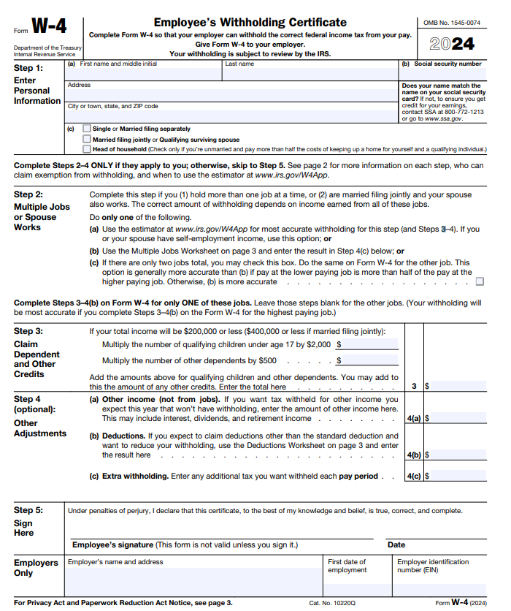
Sprintax Nonresident Tax Overview for OPT/CPT
Form W-4
pre-employment
tax document
Prior to employment you will likely need to fill out the Form W-4
This form helps your employer to deduct the correct amount of Federal taxes from your pay
It requires details such as your name, address, social security number, filing status, if you have more than one job as well as dependents and other adjustments

Slide 13
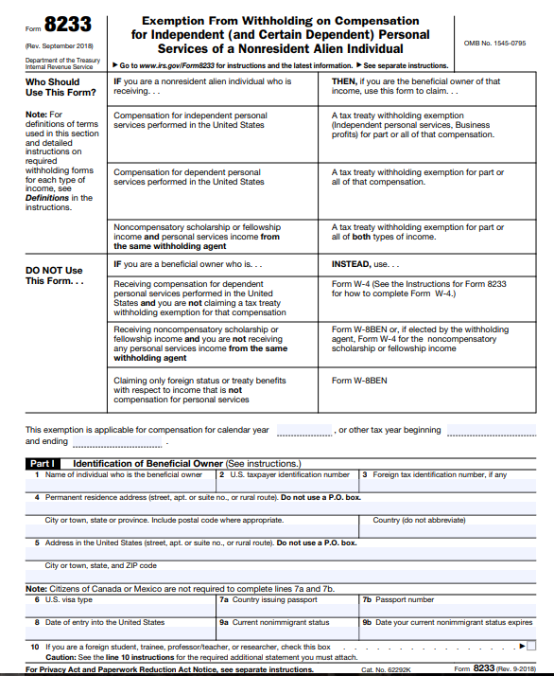

Sprintax Nonresident Tax Overview for OPT/CPT
Form 8233
pre-employment
tax document
The 8233 is a document which is primarily used to claim a Tax Treaty benefit when there is tax treaty between your country of residence and the USA
This form is used to claim a tax treaty withholding exemption for part or all of your compensation from independent personal services, dependent personal services (or wages) or compensatory scholarship or fellowship income and personal services income from the same withholding agent
A tricky document if filling this out by yourself

Slide 14
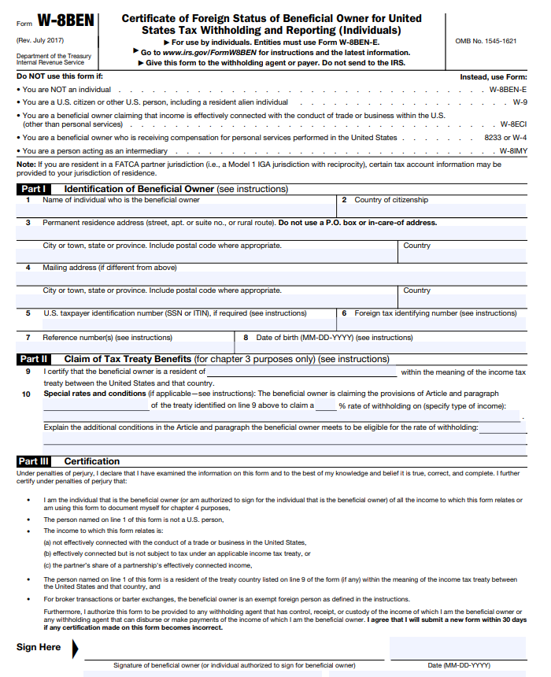
Sprintax Nonresident Tax Overview for OPT/CPT
Form W-8BEN
pre-employment
tax document
Used for claiming treaty benefits on scholarship income, royalties or other passive income
If you are receiving a separate non compensatory scholarship during your study and are eligible to claim a tax treaty benefit the W-8BEN can be used to claim
Examples of non compensatory: Tuition, Books, equipment related to course of study
Examples of compensatory: Grants provided in return for services performed e.g. Teaching assistant in order to receive housing allowance

Slide 15
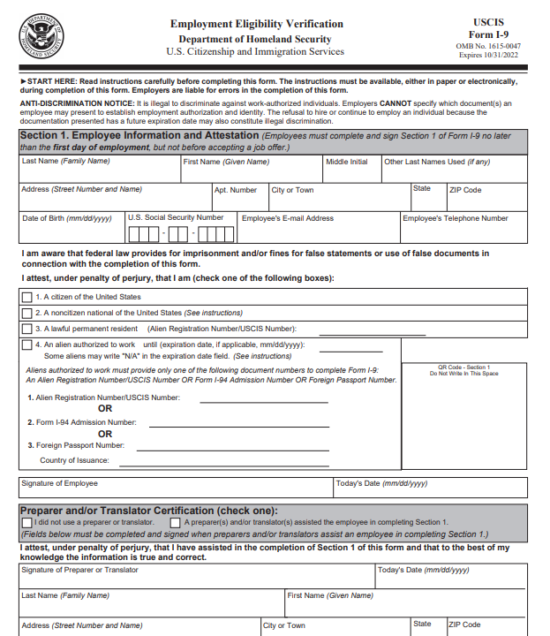
Sprintax Nonresident Tax Overview for OPT/CPT
Form I-9
pre-employment document
Used for employment eligibility
Section 1 is for the employee to fill out whilst section 2 is for the employer
If nonresident for tax purposes you will check box number 4 outlining the expiration date for your employment eligibility
You will need to outline your USCIS number, Form I-94 admission number or the number from your passport
This needs to then be signed by the employee and provided to your employer

Slide 16
Tax filing obligations for J1s

Slide 17

Important dates for tax filing
Tax filing season is for income from 1st January – 31st December
Filing deadline: Typically April 15th of the following tax year
1

Slide 18

Who must file?
Every nonresident who is an exempt individual must complete Form 8843 – irrespective of income or days of presence
As there is no personal exemption amount currently for NRAs, any nonresidents who have received taxable earnings or income over $0 will have a federal filing requirement (1040-NR)
Even if you were only present in the US for a short period, you will still need to file for that year

Slide 19
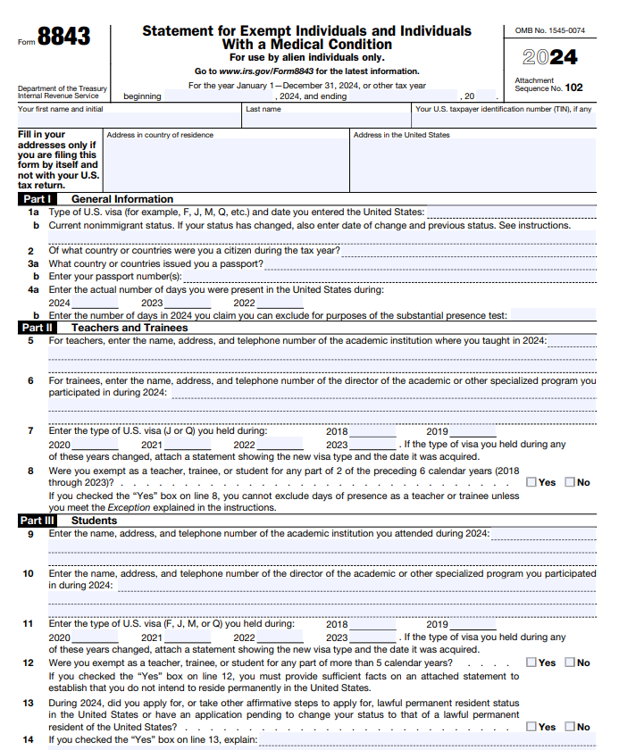
Form 8843 – minimum filing requirement for all

Slide 20
Income which does not trigger a filing requirement for nonresidents
Money transferred from parents/relatives overseas
Income ‘earned’ in home country (investment income, rent, job before moving to US, etc.)
Interest on regular savings account
A scholarship, fellowship, grant, targeted grant, or an achievement award received by a nonresident alien for activities conducted outside the United States is treated as foreign source income. (Pub. 515)
Notes:
In terms of FDAP/not effectively connected income you tend to see Jeff, what would those be and how do you manage the screening process for those payments?

Slide 21
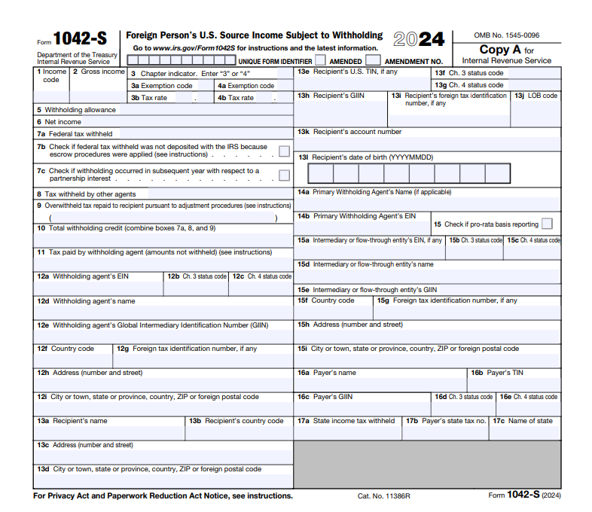
Income documents
W2 - Deadline to receive – January 31st
Outlines Wages, Salary, Compensation from the entire year (Employment Earnings)
1042-S - Deadline to receive – March 15th
Taxable Scholarships/Stipends/Non-Degree Aid
Income exempt by a tax treaty
Royalty Payments
Prize/Award/Miscellaneous foreign payments
1099 Series - Deadline to receive – typically by end of March
Rental income
Investment Income
Commissions
Independent Contractor Services
Note: Au Pairs likely will not receive an income document – they should keep records of the payments made to them by host family

Slide 22
Nonresident spouse and dependents
Same filing requirements as visa holder:
No joint returns for nonresidents
Obligations
  Minimum is Form 8843
  1040-NR if applicable
  Each dependent should mail them in separate envelopes
Nonresident can elect to file as resident – when married to a tax resident - but do the math on both options first!

Slide 23
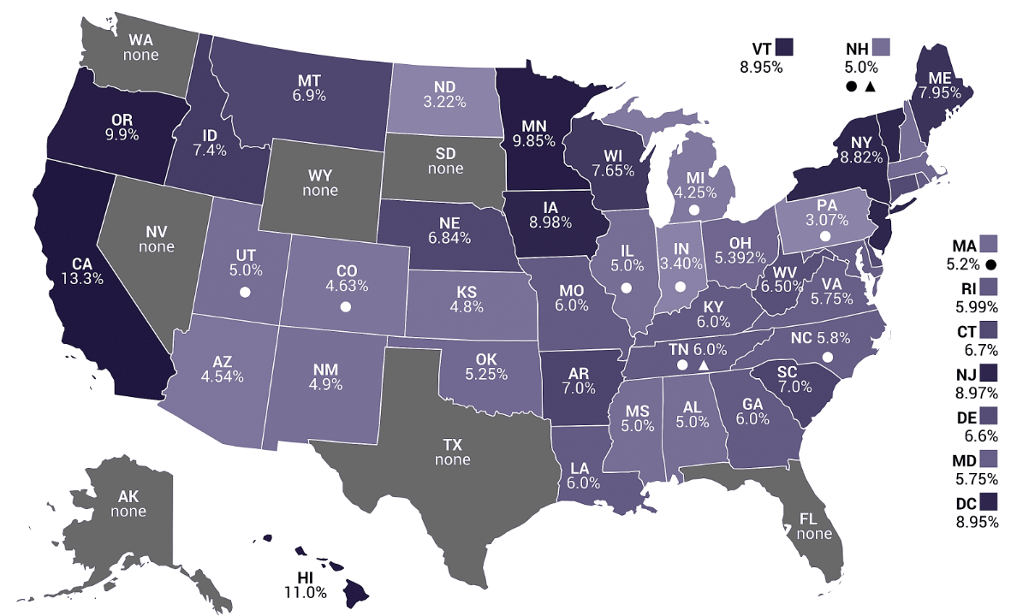
The Nonresident Tax Clinic
State taxes
Resident, part-year resident and nonresident status
Forms and rules vary from state to state
Federation of Tax Administrators website www.taxadmin.org/state-tax-forms

Slide 24
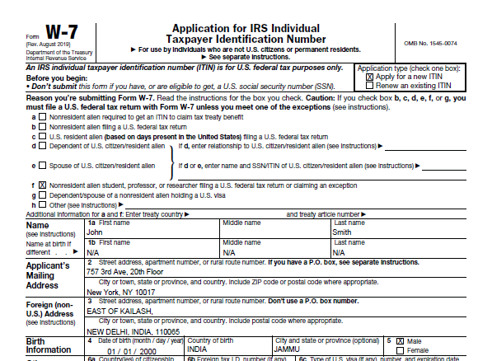
What if I don’t have an SSN when filing? -
Individual Taxpayer Identification Number (ITIN)
Instructions for applying for an ITIN while filing your tax return:
When nonresidents are filing an ITIN application alongside a tax return, the responsible officer at the institution can no longer certify the documents they are providing unless they are a certified acceptance agent.
The following steps are advised if nonresidents are applying for an ITIN alongside your tax return. When mailing ITIN application, include:
  1040 NR (Your Federal tax return)
  ITIN application (Form W-7 signed)
  Attach a certified copy of the applicant’s passport.
If including a photocopy of their passport, it must be certified by one of the following*:
  Certified Acceptance Agent or IRS official
  The governmental department that issued the identification document.
  The United States Embassy or Consulate (make a reservation before visit).

Slide 25
Implications of misfiling

Slide 26

Missed a year? Filed as a resident by mistake?
Don’t panic!
  but do set the record straight
Never filed…
  Catch up
  Can back file at any stage
  Can only claim a refund for previous 3 years
Misfiled…
  1040X - Amended US Individual Income Tax Return
  Simple form, similar to 1040

Slide 27

Implications of not filing
Nonresidents are required to comply with all US laws, including IRS & filing tax forms (even if only 8843).
Remaining compliant is part of maintaining visa status in the US.
Not filing could affect future immigration status (like H1B, LPR)
Fines, penalties and interest can accrue if the IRS are owed
Might be missing out on a refund!

Slide 28
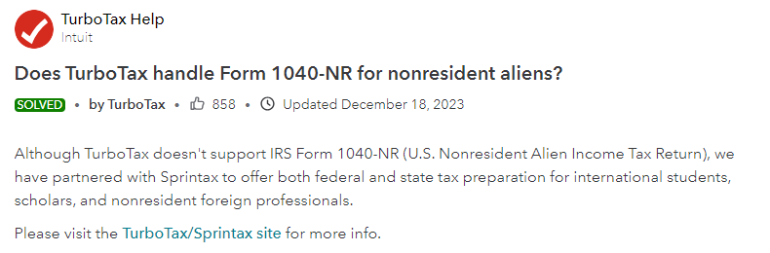
Be careful about options being “recommended” to you!
Be careful when social media groups are recommending tax companies
Doing the research on finding legitimate NRA tax service providers is crucial
TurboTax only supports resident returns
We helped over 12,000 nonresidents to amend their tax returns over the last 3 years

Slide 29

Sprintax solutions

Slide 30

Sprintax Returns
Software to assist with their nonresident tax filing requirements
Services:
  Federal return
  State return(s)
  Form 8843
  FICA return
  Amended Returns
  Post filing support
  ITIN application

Slide 31

Sprintax Forms
Software to prepare pre-employment tax documents
Ensuring that you are taxed correctly on your income
Sprintax Forms will generate any applicable tax forms for J1s, such as the W4, W8BEN and 8233, all they need to do is sign and provide them to their employer
Separate to any end of year filing

Slide 32

Sprintax Au Pair
Software to assist au pairs with calculating and paying their estimated taxes during the year
Au pair host families are not required to withhold tax and issue a W-2, so most au pairs end up owing a large sum when filing their taxes

Slide 33

J1 Bundle
https://taxprep.sprintax.com/lp/j1-full-service
Bulk pre-purchase of services at a discounted rate!
Services:
  Federal return
  State return X2
  Post filing support
  FICA return
  Sprintax Forms

Slide 34

More available support
Educational tax videos on YouTube
Blog content for tax awareness
24/7 live chat
Tax workshops and webinars

Slide 35

Thanks for tuning in!
Any questions?
Access our live chat through your Sprintax account!

